Slide 1
Development of style e tactical (SET) model
Sanmuga Nathan (PhD)
Sultan Idris Education University of Malaysia
sanmuga@fsskj.upsi.edu.my
(School teacher, senior lecturer, IAAF qualified coach, IAB member of TGfU)

Slide 2
Malaysia: Sports and Physical Education
Badminton, Hockey, Squash, and Cycling, Diving (Football favorite game in Malaysia) and Sepak Takraw traditional game
Physical Education: Traditionally we follow British system
Nowadays we follow the 21st century education approach (ICT & Inquiry learning are embedded in PEHE curriculum)
PEHE is a compulsory subject in Malaysian school
Pedagogical approaches in PE: Traditional we use direct instruction (Command, Reciprocal style and skilled based Technical model ) teaching open skill and closed skill sports and games
Currently: TGfU (Games) , Cooperative learning, Inquiry learning (HE) & Direct approach, Skilled based Technical model & Mastery learning (closed skill sports)

Slide 3
Higher Education Intuition in Malaysia (PE, Sports Science. Sports Coaching )
Teachers Education Institutes
Sultan Idris Education University (UPSI)
Putra University of Malaysia
University of Malaya
University of Technology Mara
University Science Malaysia
University of Technology of Malaysia
Management & Science University

Slide 4
The Style ‘E’ Tactical (SET) Pedagogical Model
Initial stage of development of the Style ‘E’ Tactical (SET) Model
Eclectic game based approach (GBA)
. The SET is a combination of two pedagogical approaches: Mosston and Ashworth’s Spectrum Teaching Style E and Bunker and Thorpe’s original Teaching Games for Understanding (TGfU).
To test the efficacy of this new model, the SET was compared to two other teaching approach: SBT (Style B Tactical and Style H Tactical)

Slide 5
The value of developing the integrated SET pedagogical model
To development of strong conceptual framework game based learning and teaching at macro level supporting TGfU
At micro level with the intention catering the students with different levels of ability and varying skill levels in game play using Inclusion Style (E) – as TGfU overlook ability and skill levels
Supporting and comprehend Style E (Spectrum of Mosston Teaching Styles) and TGfU as to be more holistic Game Based Approach

Slide 6
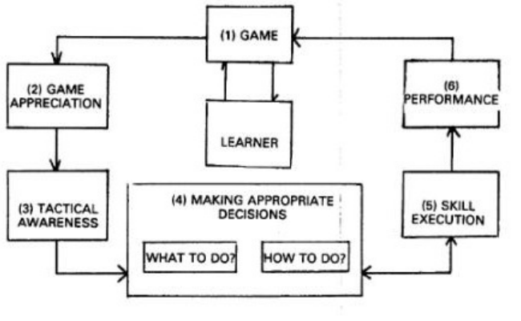
Heuristic development of SET Pedagogical model
Pre-impact set (planning and lesson plan)
Impact-set (during teaching and learning)
Manipulation of 6 steps of TGfU & Style E
Game form
Game Appreciation
Tactical Awareness
Decision making (What to do & How to do)
Skill execution
Performance (measured game play assessment)
TGfU lesson tasks were prepared in accordance
to Style E (Inclusion) : High difficulties, Medium difficulties and low difficulties
post-impact set
Game based assessments
Reflections

Slide 7
SET Lesson structure
Warm up activities (game play form)
Tactical discussion via guided discovery (when to pass and dribble)
Tactical application in small sided game play
Skill/technical discussion via guided discovery (how to pass and dribble (low dribble, high dribble and Indian dribble)
Skill drills (passing, dribbling skills)
Skill application and tactics in game play situations
Advance game play situation for higher skill group
Limbering and cooling down
Reflection and assessments (skill, decision making, enjoyment& cooperation)

Slide 8
Practical example a unit of lesson plan in hockey for form 2 students (14 years old)
Learning standard based Malaysian School PE Curriculum
Psychomotor:
1.2 :To be able to pass, dribble ball in hockey game play situations
Cognitive:
2.3 :To be able to make tactical decision when to pass or dribble
Affective:
3.1: Able to enjoy and cooperate with teammates while playing in a game play

Slide 9
Learning Objectives
Psychomotor:
1.High skill: Able to pass and dribble ball (close, loose and Indian dribble) in game play situation of 3 vs.3 and 4 vs.4 (one touch game play) using area of 30m x20m
2. Medium skill: Able to pass and dribble ball (close, loose and India dribble) in game situation of 3 vs.3 using area of 30x10m
3. Low skill: Able to pass and dribble (close and loose dribble) in game situation of 3 vs.3 using area of 30x10m
Cognitive:
Able to make decision when to pass or dribble in game situations of 3vs.3 or 4vs.4
Affective:
Able to enjoy playing in a game play of 3vs.3 or 4vs.4

Slide 10
Skill levels | Practical Lesson Example: Passing and dribbling in Field hockey
High skill Activities | Warming up (student lead roll/tap ball activities & Dynamic stretching) Discussion: Tactical decision making (when to pass and dribble; types of dribbling skills) Game play 1: 3 vs .3 (30m x 20m) (Tactical application) Discussion (Cues): Technical skill passing, dribbling (low, high and Indian dribble) Skill drill passing and dribbling (low dribble , high dribble and Indian dribble) Game play 2: 4 vs. 4 (30 x 20m) (Application tactics and skill technique) Limbering down, assessment and reflection
Medium skill Activities | Warming up (student lead roll/tap ball activities & Dynamic stretching) Discussion: Tactical decision making (when to pass and dribble; types of dribbling skills) Game play 1: 3 vs .3 (30m x 10m) (Tactical application) Discussion (Cues): Technical skill passing, dribbling (low, high and Indian dribble) Skill drill passing and dribbling Game play 2: 3 vs. 3 (30 x 10m) (Application tactics and skill technique) Limbering down, assessment and reflection
Low skill Activities | Warming up (Teacher lead roll/tap ball activities & Dynamic stretching) Discussion: Tactical decision making (when to pass and dribble; types of dribbling skills) Game play 1: 3 vs .3 (30m x 10m) (Tactical application) Discussion (Cues): Technical skill passing, dribbling (low and high dribble) Skill drill passing and dribbling Game play 2: 3 vs. 3 (30 x 10m) (Application tactics and skill technique) Limbering down, assessment and reflection

Slide 11
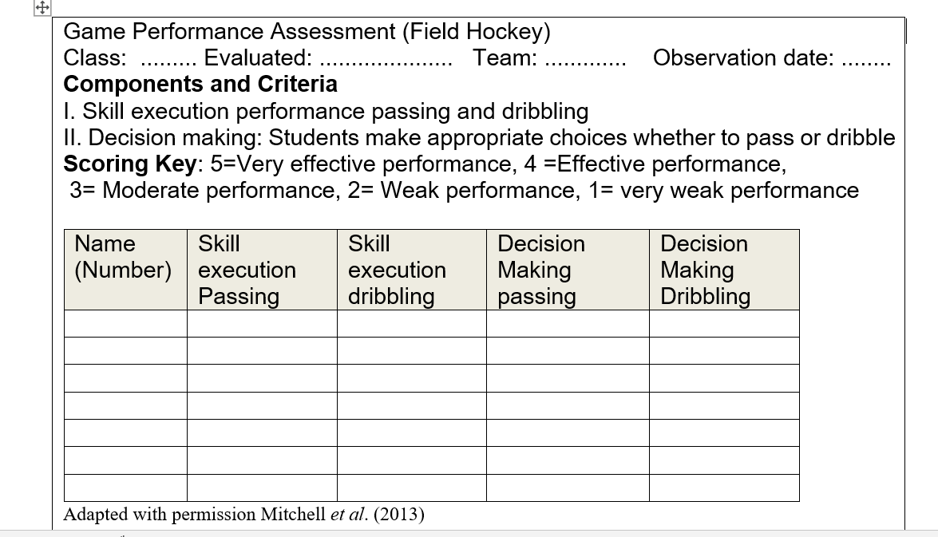

Slide 12
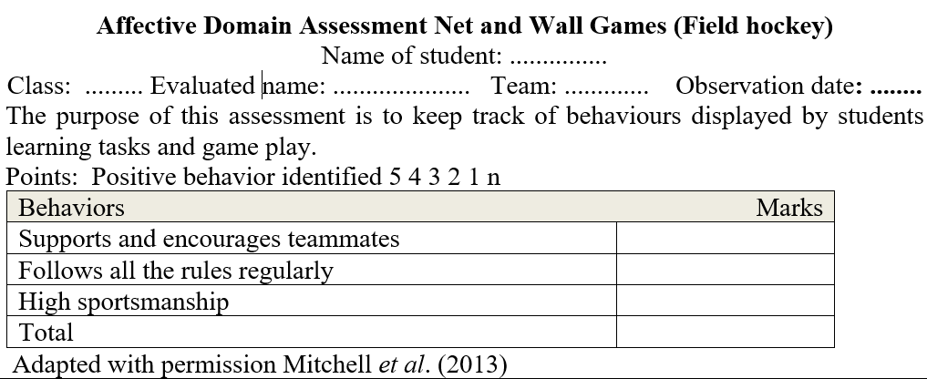

Slide 13
Preliminary research of SET Pedagogical Model
A quasi–experimental study and triangulated qualitative focus-group interview was conducted to measure the efficacy of SET model
Findings indicated SET pedagogical model achieved learning outcomes that were better than equal other two teaching models (Style B Tactical and Style H Tactical) in field hockey performance
Speed and accuracy general hockey skill
Declarative & Procedural knowledge
Tactical decision making (what skill to choose)
Focus group interview: Enjoy playing game especially using SET model
Further testing of this model with other sports and in other cultural contexts is recommended.

Slide 14
References:
Bunker D, &Thorpe, R. (1982). A model for the teaching of games in the secondary schools. The Bulletin of Physical Education, 10:9-16
Mitchell, S., Oslin, J.L, & Griffin L. (2013). Teaching sport concept and skills. A tactical games approach for ages 7 to 18. Human Kinetics, :1-259.
Mosston, M.,& Ashworth, S. (2008). Teaching Physical Education, 5th ed, New York: Benjamin Cummings
Nathan S. (2008). The effects and sustainabilities of training programmes using tactical model of TGfU with different teaching styles on students with varying hockey skills level. Paper presented at the Asia Pacific Sports Education Conference. 21 January 2008; Flinders University, Australia
Nathan, S., & Haynes, J. (2013). A move to an innovative games teaching model: Style E Tactical (SET).,4(3):287-302. DOI: 10.1080/18377122.2013.836769Asia-Pacific Journal of Health, Sport and Physical Education
Nathan,S & Ratnavadivel, N. (2012). Exploring Mosston’s Spectrum of Teaching Styles usage and perception among student teachers of Sultan Idris Education. Journal of Research, Policy & Practice of Teachers & Teacher Education Vol (1), 33-44.

Slide 15
My thanks

